Slide 1

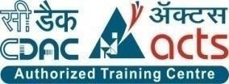
E-RTO System
Presented By:-
Group No: 57
Kapil Prajapati (223087)
Shubham Jaiswal (223200)

Slide 2
Points to be discussed:
Introduction
Motivation
Objectives
Technology Used
UML Diagrams
Screenshots
Specification
S/W and H/W Requirements
Advantages
Conclusion
Future Scope
Reference's

Slide 3
INTRODUCTION
The e-RTO System's aim is to automate the major processes in Regional Transport Offices. The Online RTO system provides citizens with 24/7 access to services like online registration for Learner’s licenses & Permanent licenses. Admin can update application status and can also manage time slots for tests. The main motive of the system is to make daily activities efficient and to provide a fast response by storing and retrieving information & informing to users via Email.

Slide 4
MOTIVATION
Now a day’s many people are purchasing two-wheelers, four-wheelers, etc. So the RTO employees have a lot of work burden of making registration. License issues, transfers, etc. which required a lot of paperwork. As a result, people cannot get things done at the right time, which wastes the time, and energy. So to overcome these drawbacks we are developing an enhanced e-RTO Management System. Such like that we provide one type of environment which gives a user-friendly means users can access and understand well. The administrator has the power to verify the data entered by the user, processing of data, and provide appropriate solutions.
E-RTO Management system is an advanced system that is designed keeping in view to make the existing registration system easier and faster. It includes the entire registration procedure starting from the initial phase of entering till the results. It is more reliable, accurate time, saving, and free from any misuse. The tedious jobs such as verifying all the records of the applicant, confirming all the personal details are furnished, submission of documents, driving license, registration details, etc. are done in the most convenient way to the administrator. Also, security is being provided in the most proficient way.

Slide 5
OBJECTIVE
The aim is to build a user-friendly webpage where citizens can apply for a learner’s license or driving license. The webpage also provides provisions for citizens to submit their complaints. Mainly, the website is used for issuing licenses. An individual can apply for a learning license and driving license online. Accordingly, slots and dates are generated for the respective test. The application received will be verified and approved by the RTO officials. The applicant can monitor the status of their application.

Slide 6
Technology Used
Front End: React Js
Back End: Java Spring Boot API.
Back-end database: MySQL

Slide 7
UML DIAGRAMS

Slide 8
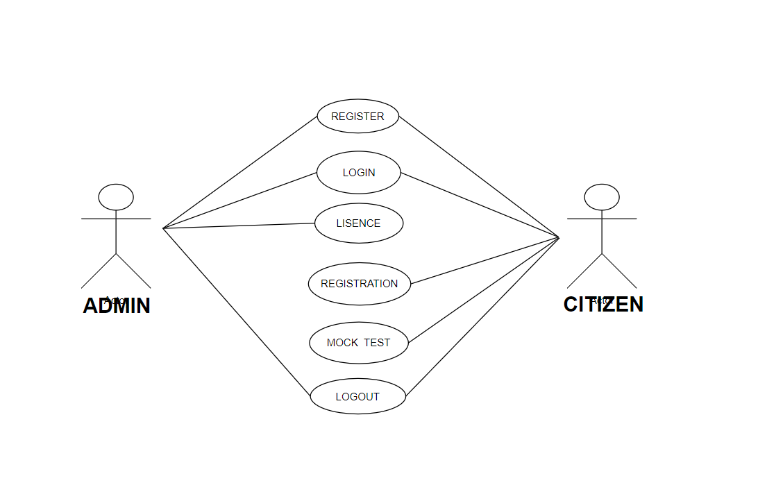
UseCase Diagram

Slide 9
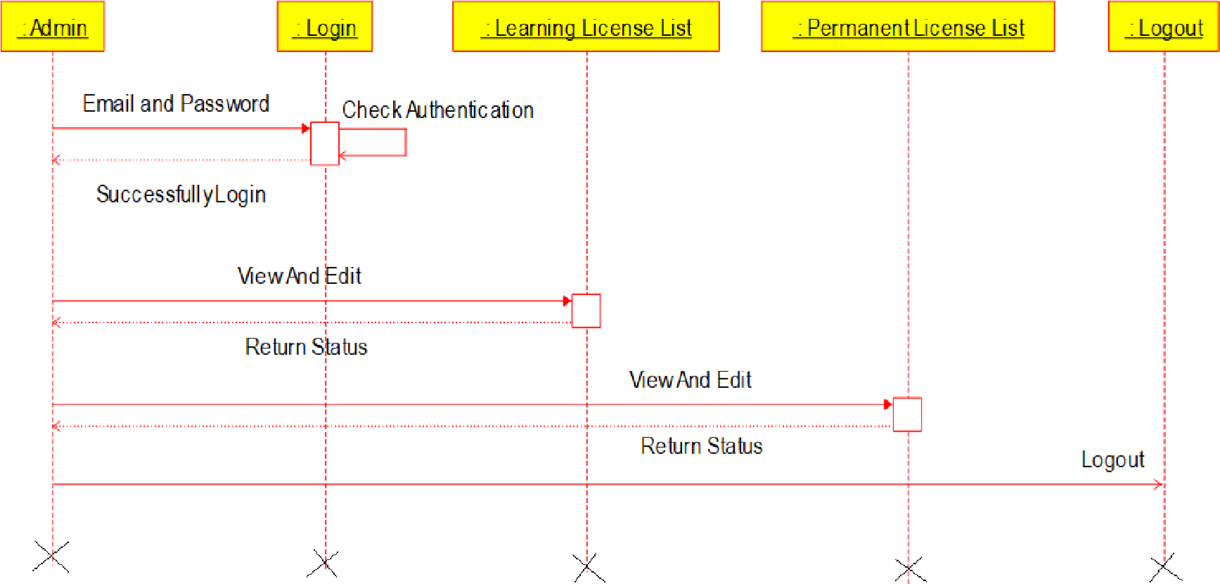
Admin’s Sequence Diagram

Slide 10
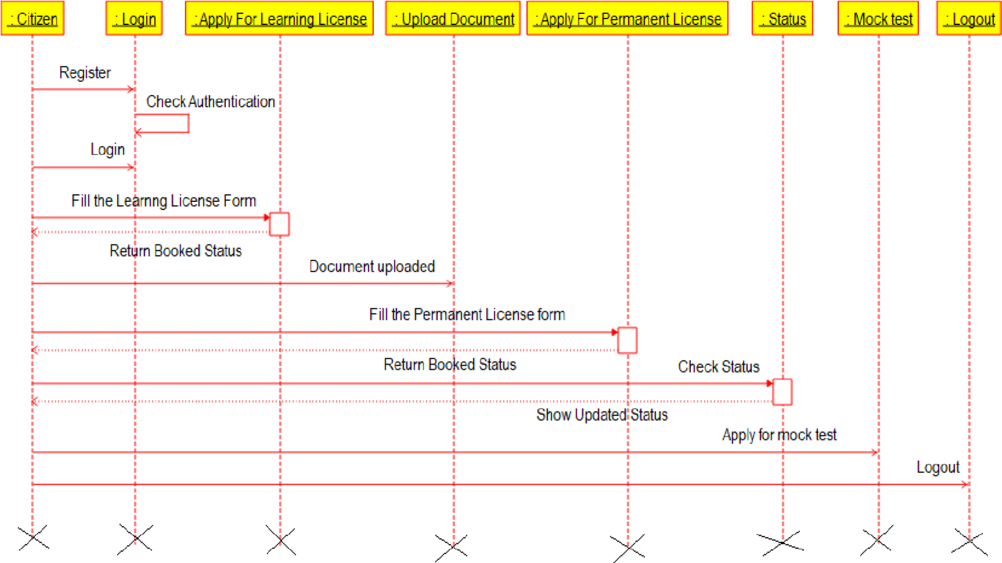
Citizen Sequence Diagram

Slide 11
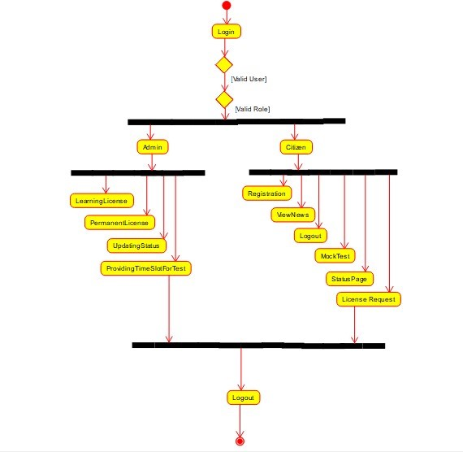
Activity Diagram

Slide 12
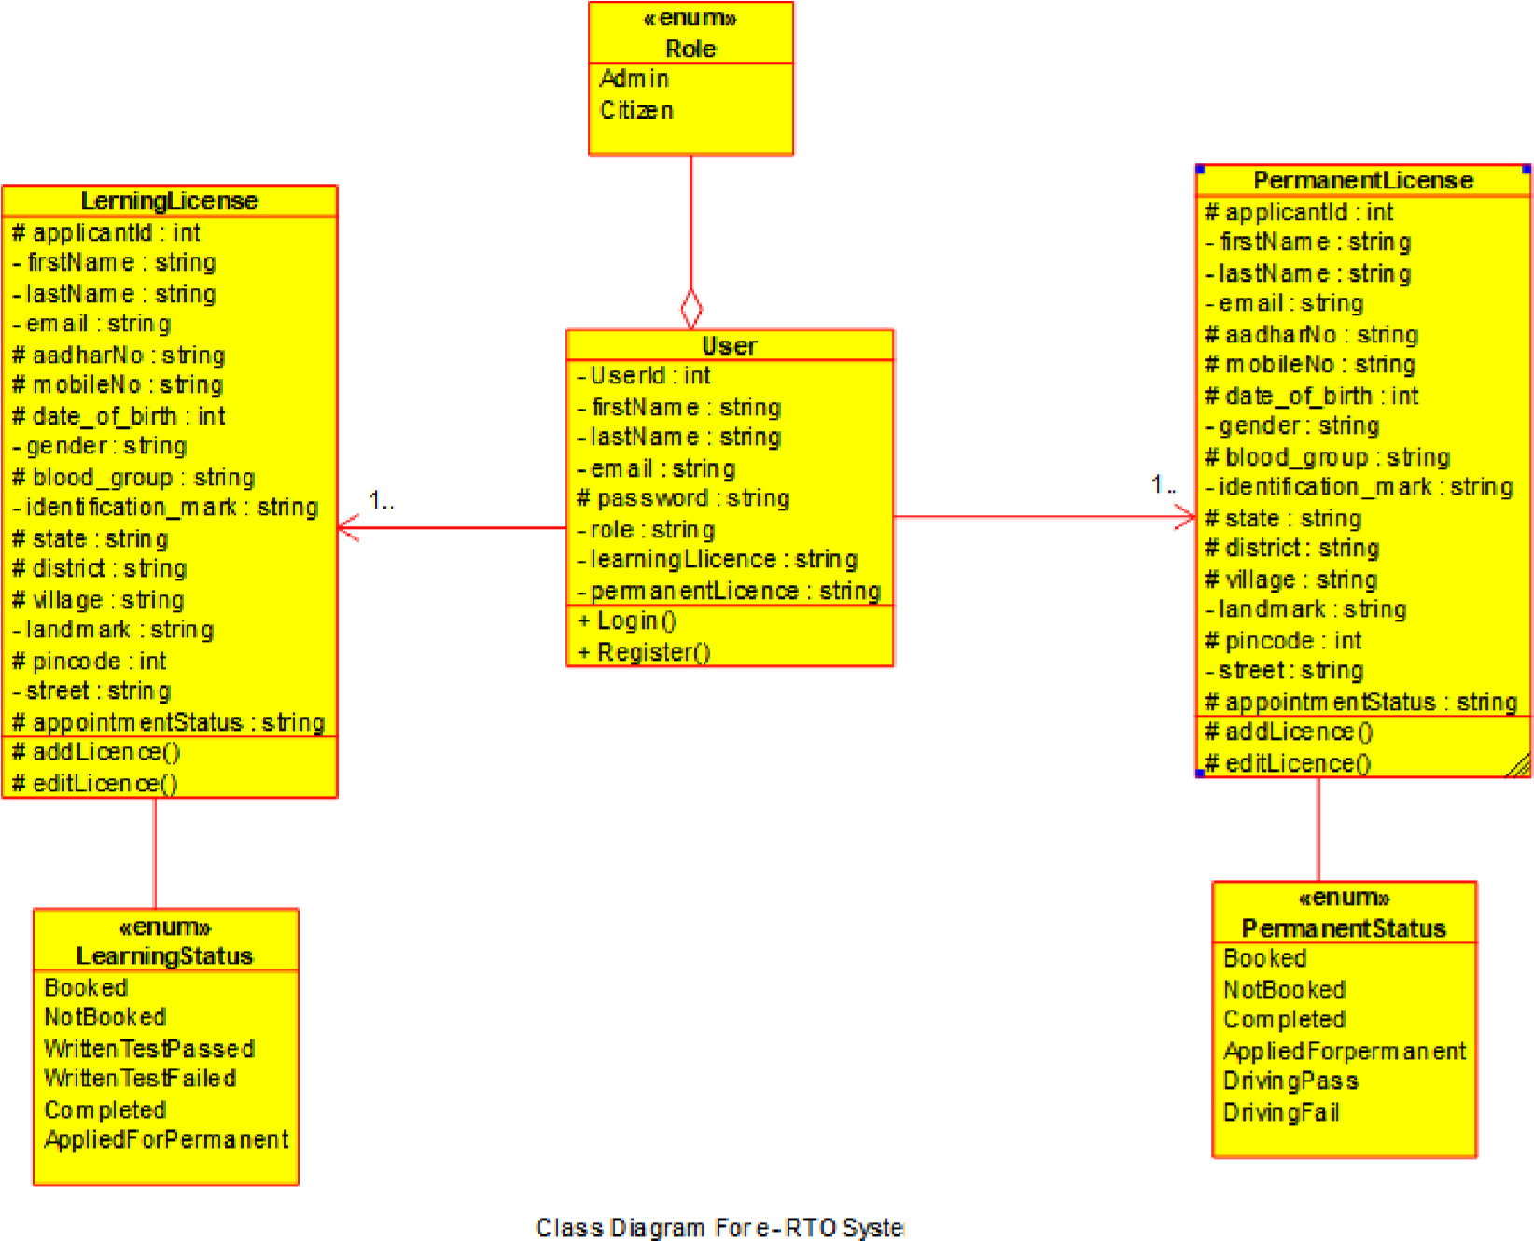
Class Diagram

Slide 13
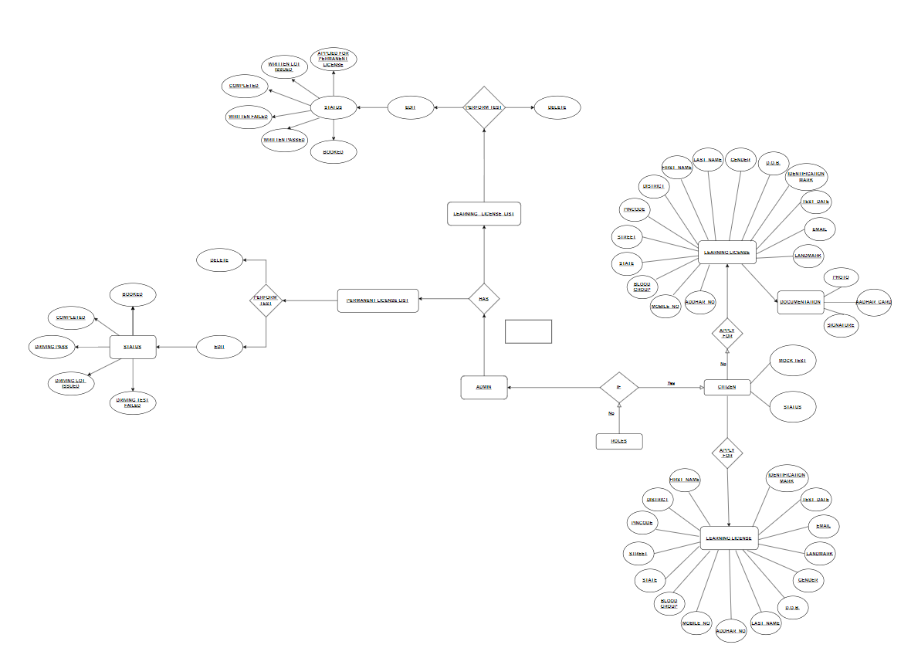













ER Diagram

Slide 14
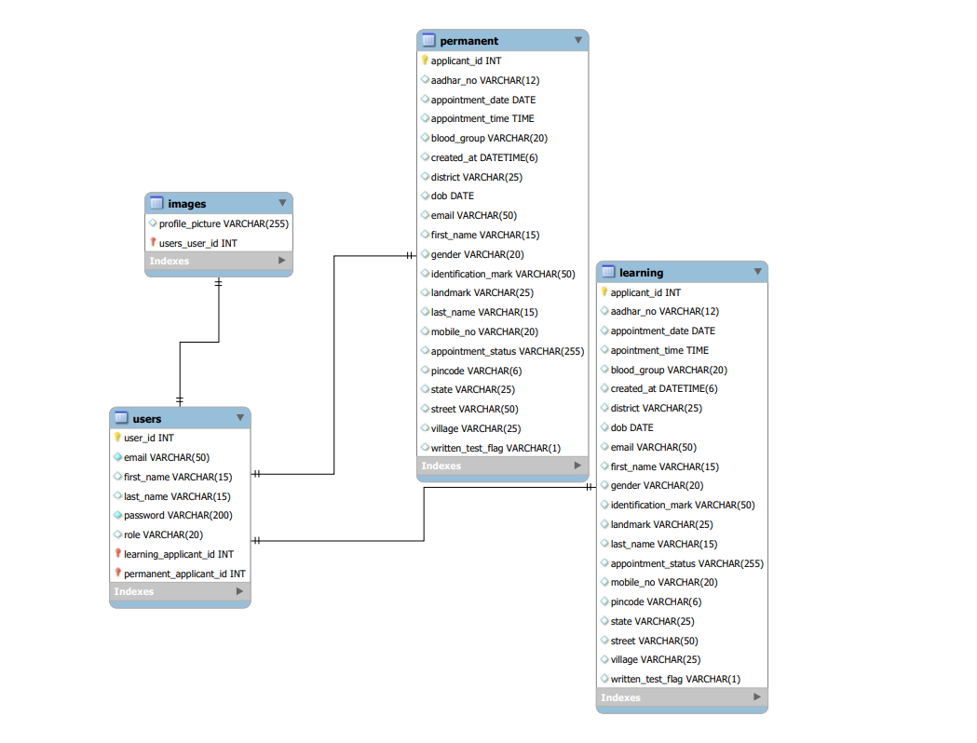
ER Diagram

Slide 15
SCREENSHOTS

Slide 16
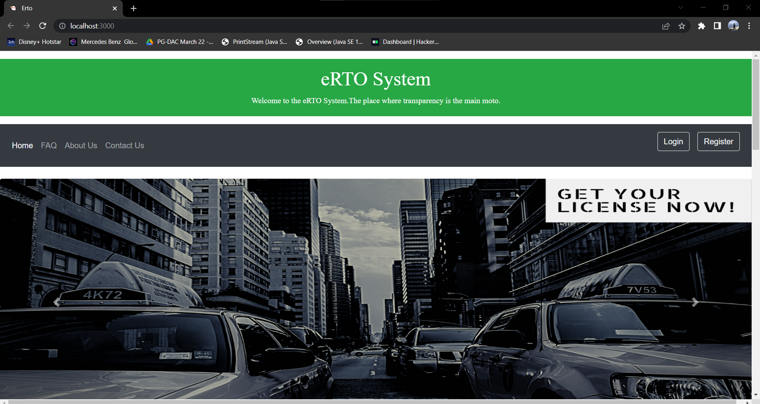
HOMEPAGE

Slide 17
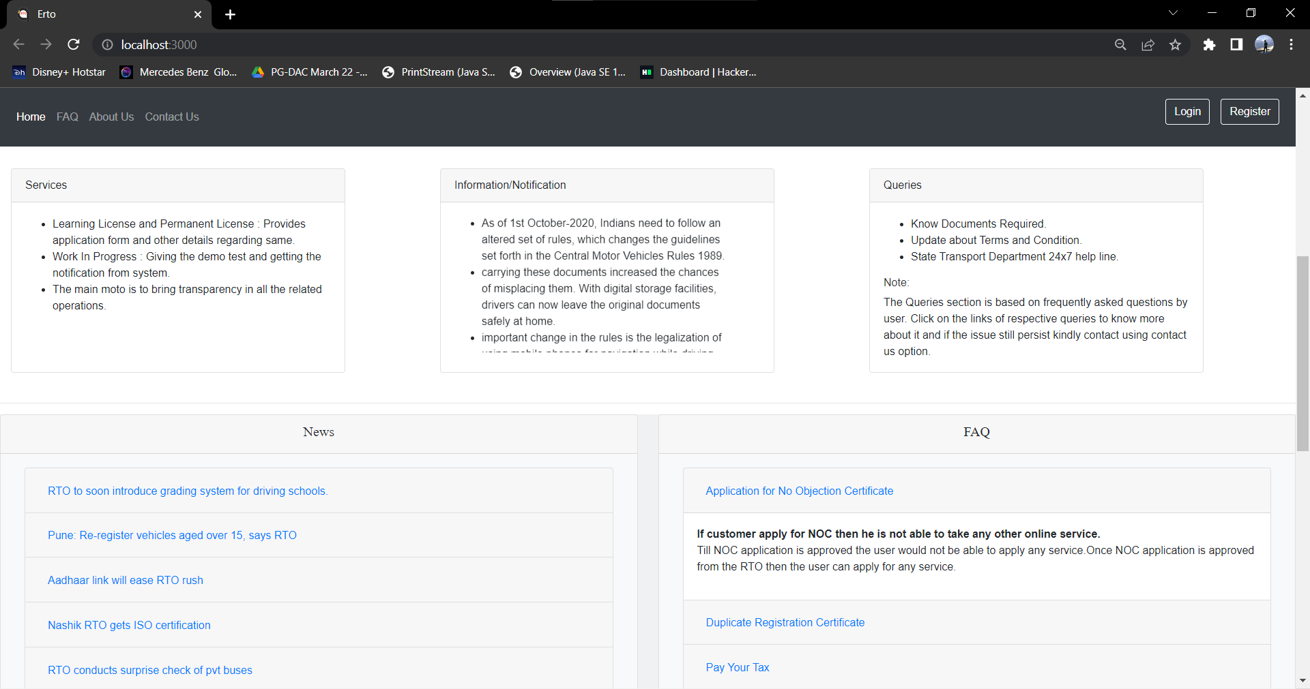

Slide 18
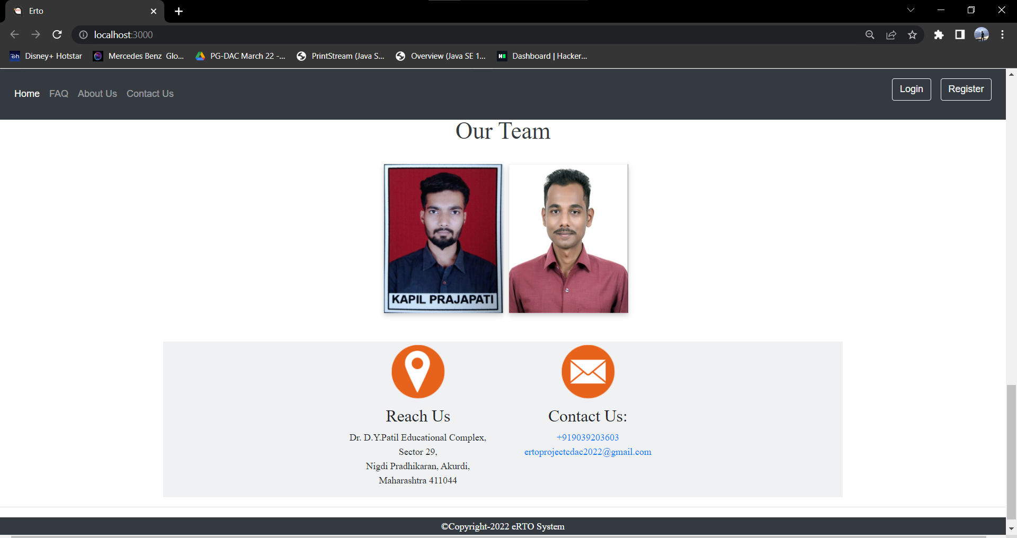

Slide 19
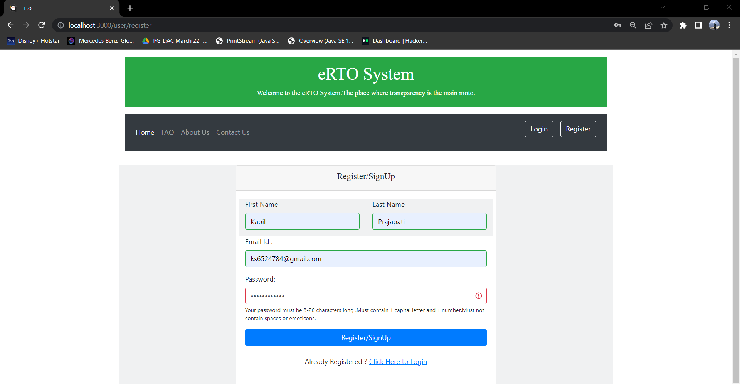
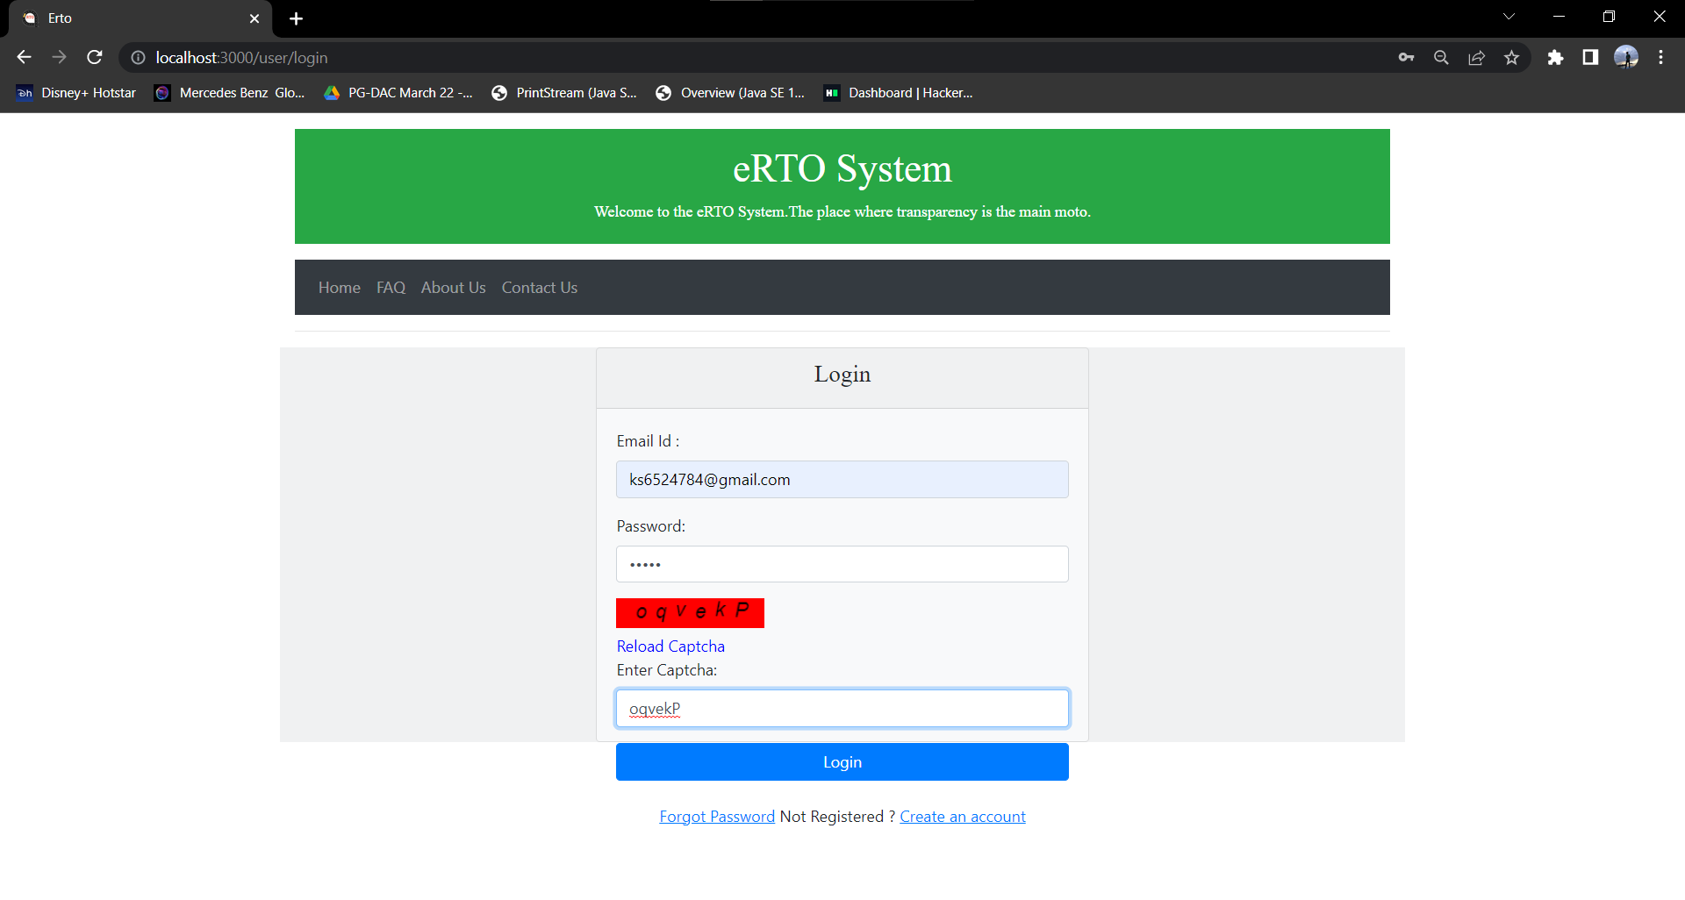
REGISTER PAGE
LOG-IN PAGE

Slide 20
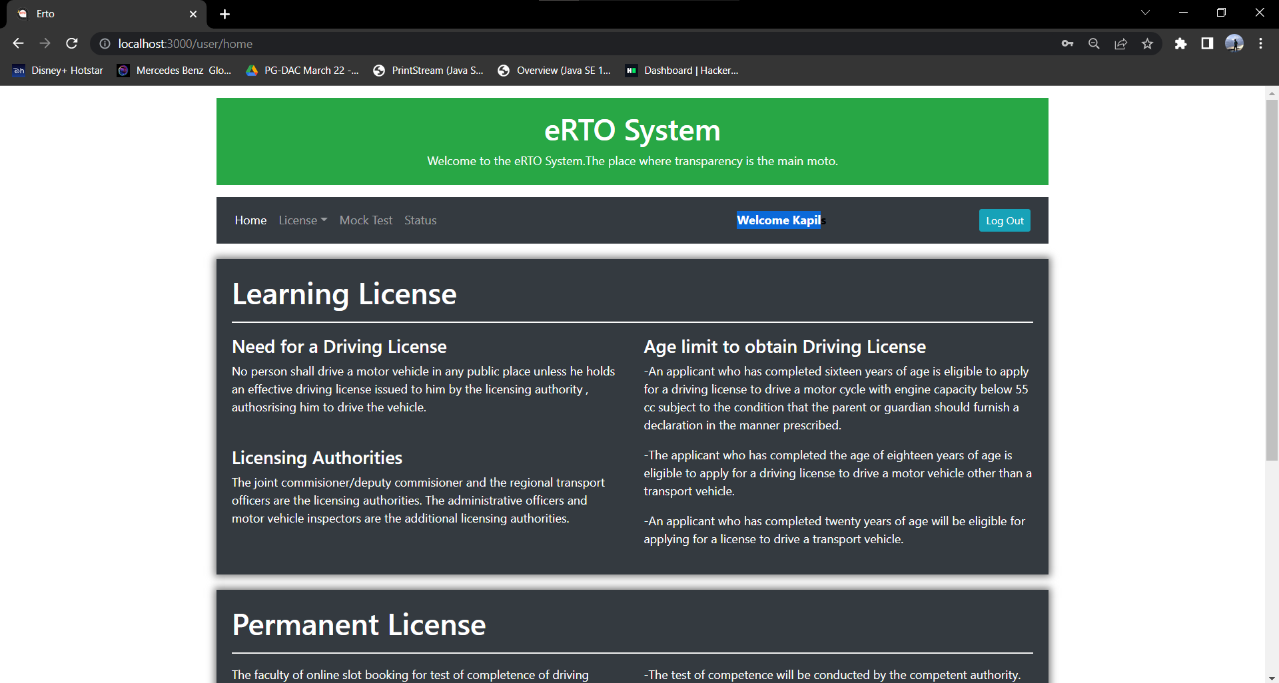
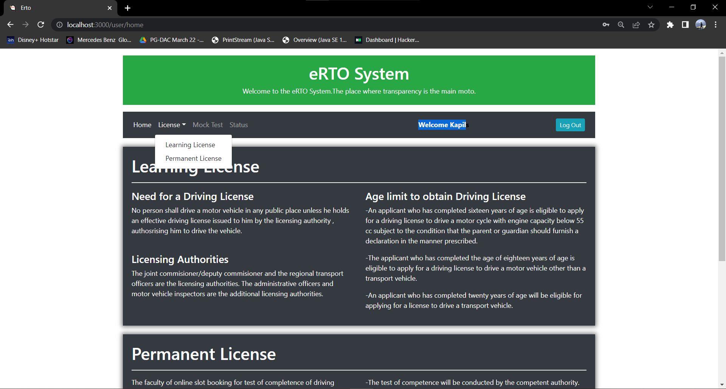

Slide 21
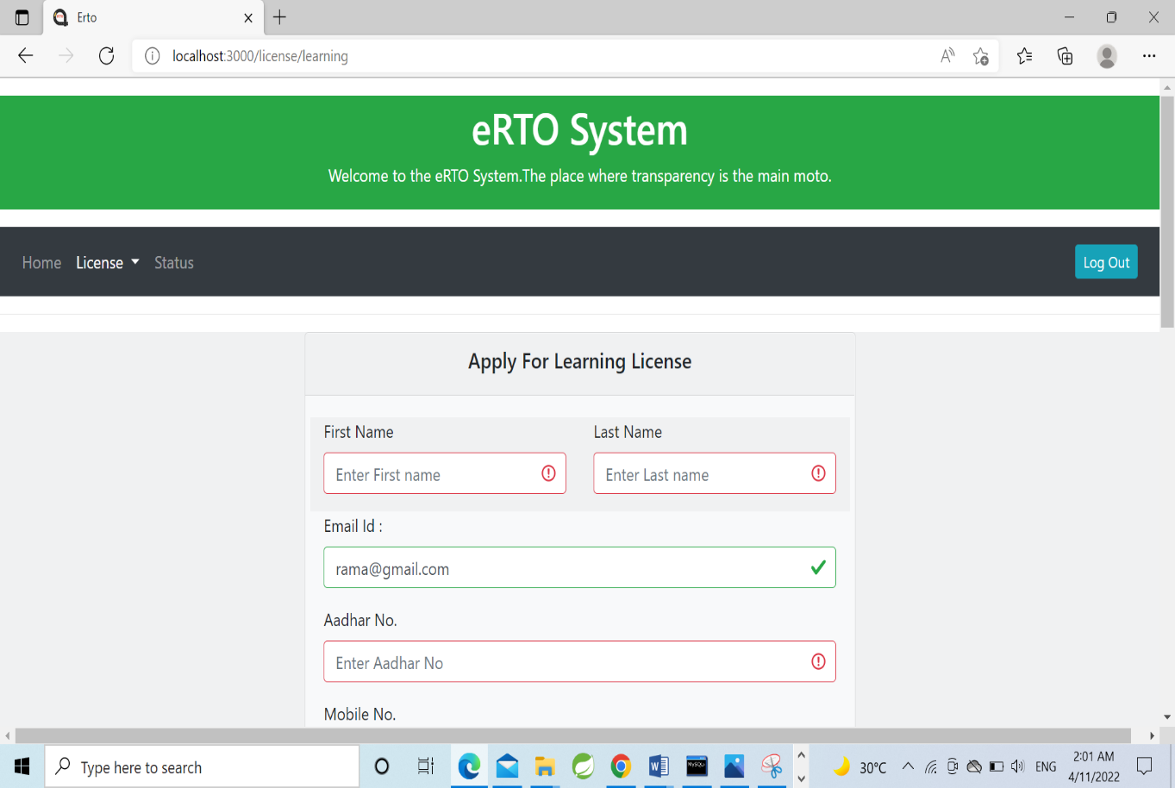
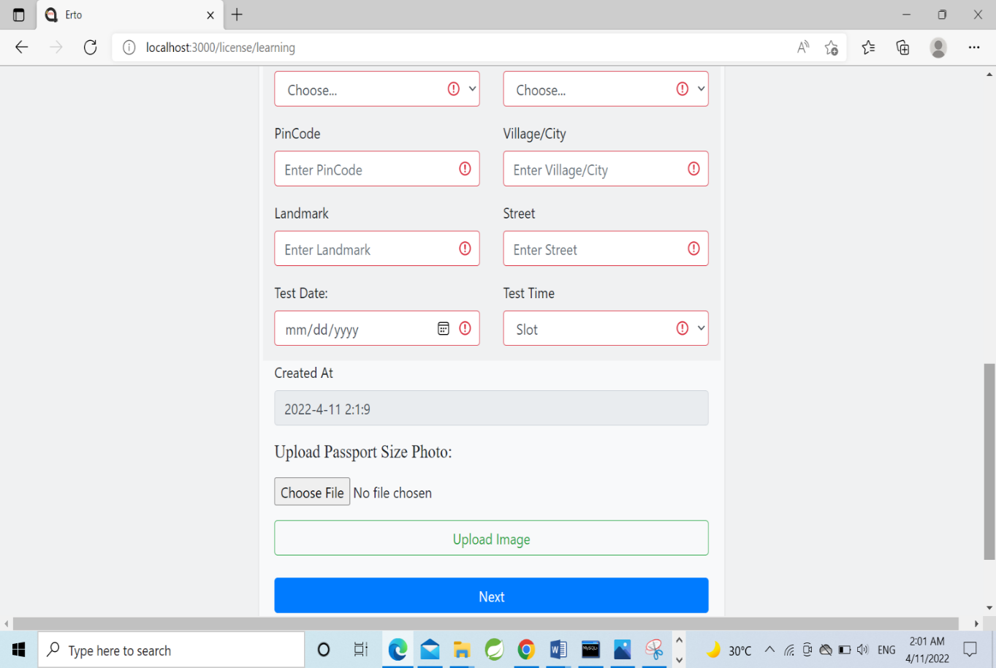

Slide 22
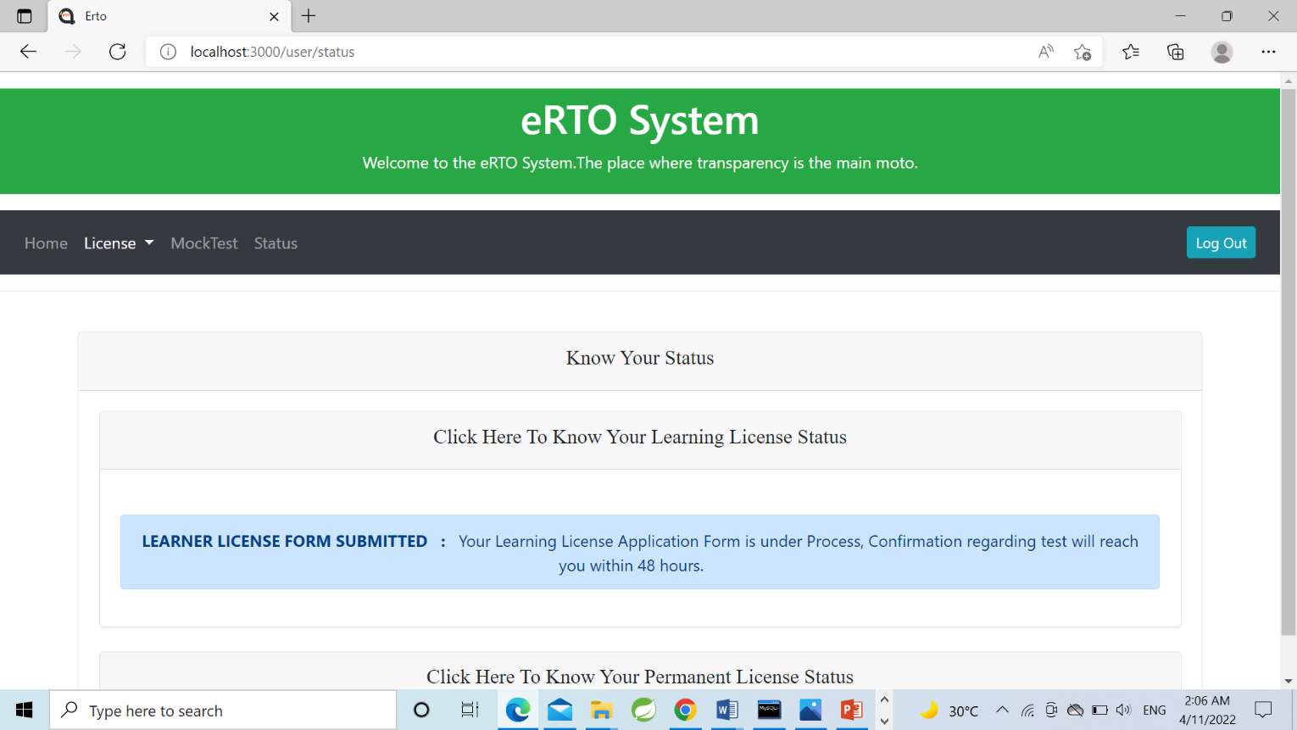
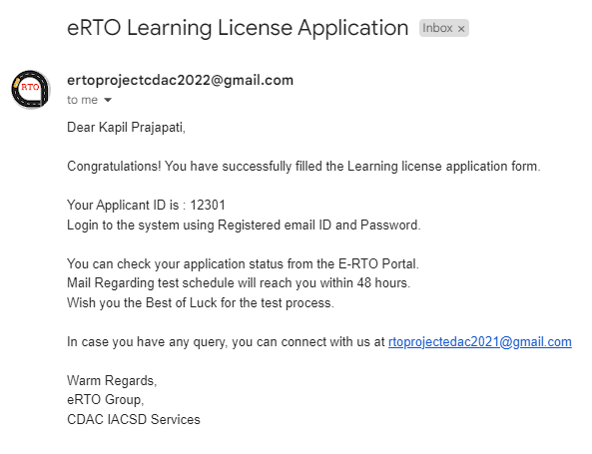
2

Slide 23
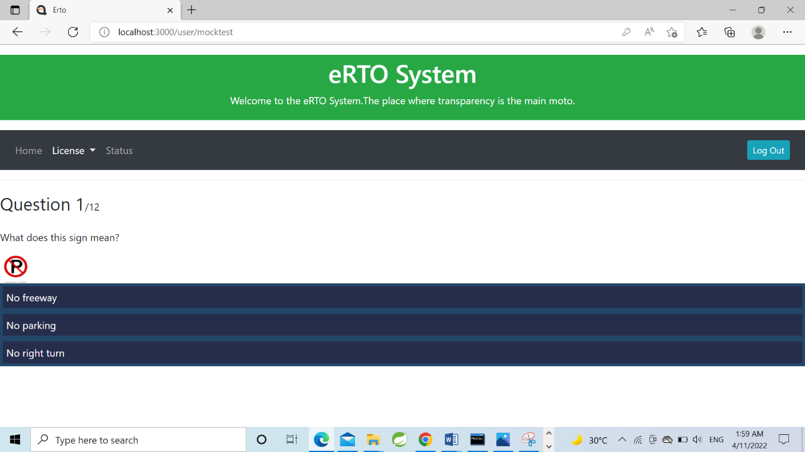
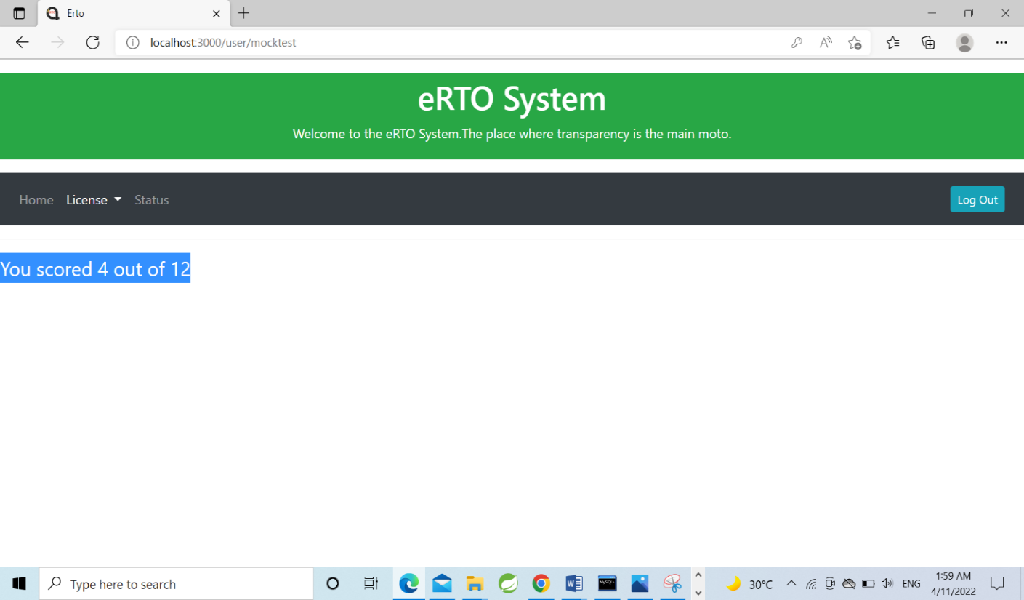
MOCK TEST PAGE
TEST RESULT PAGE

Slide 24
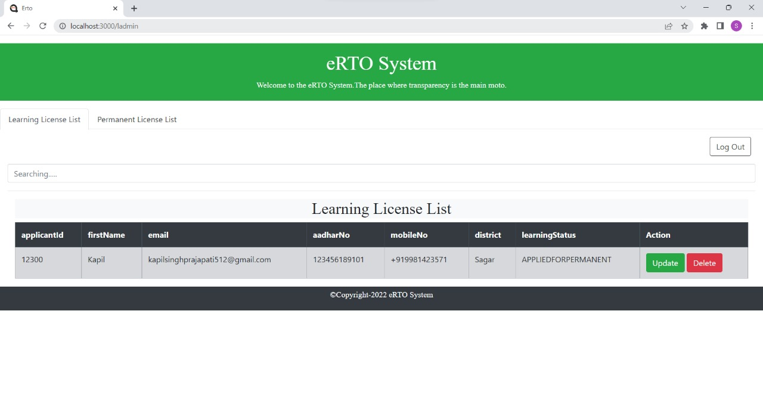
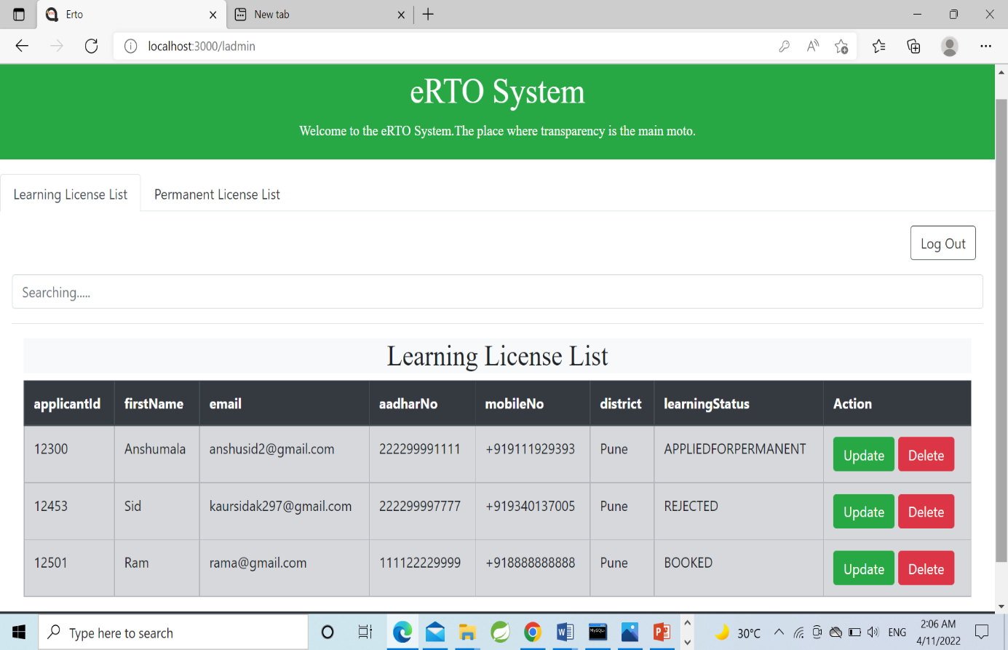
ADMIN DESK PAGE

Slide 25
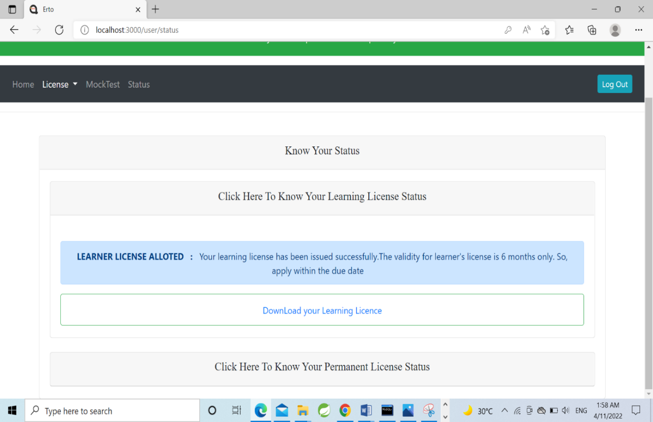
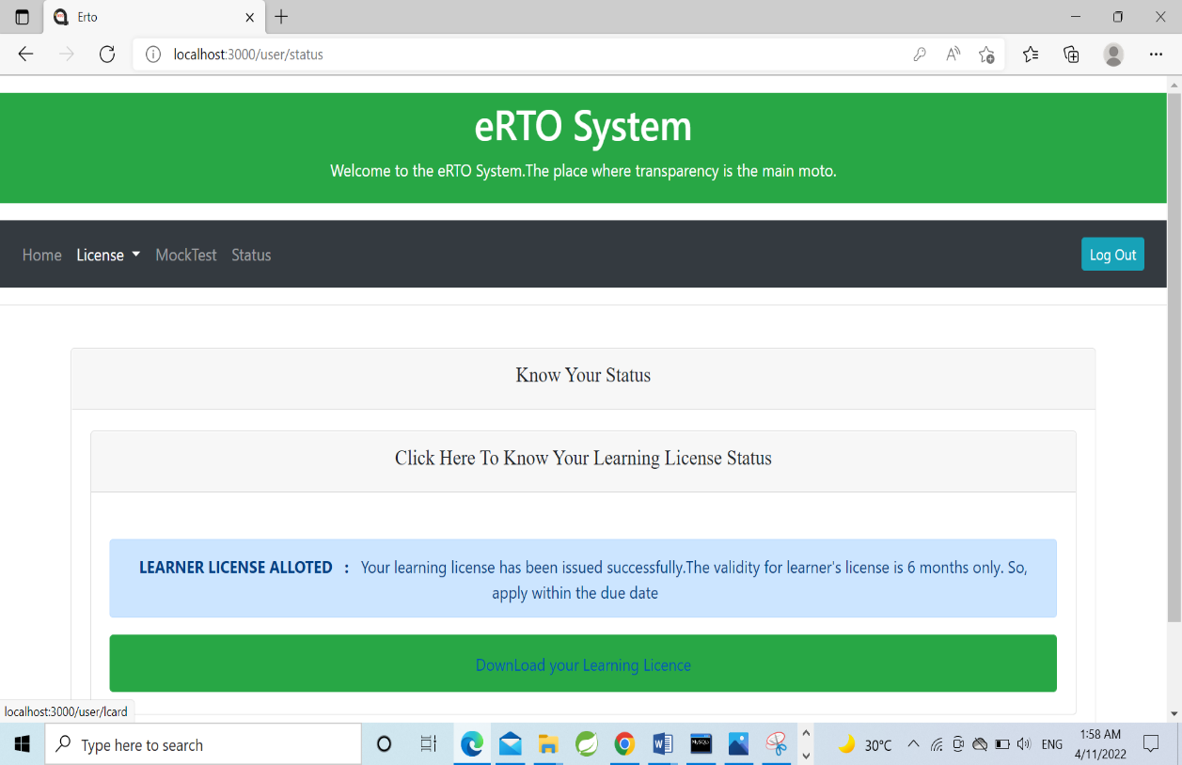
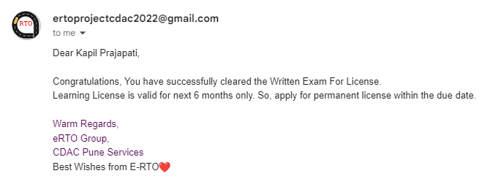

Slide 26
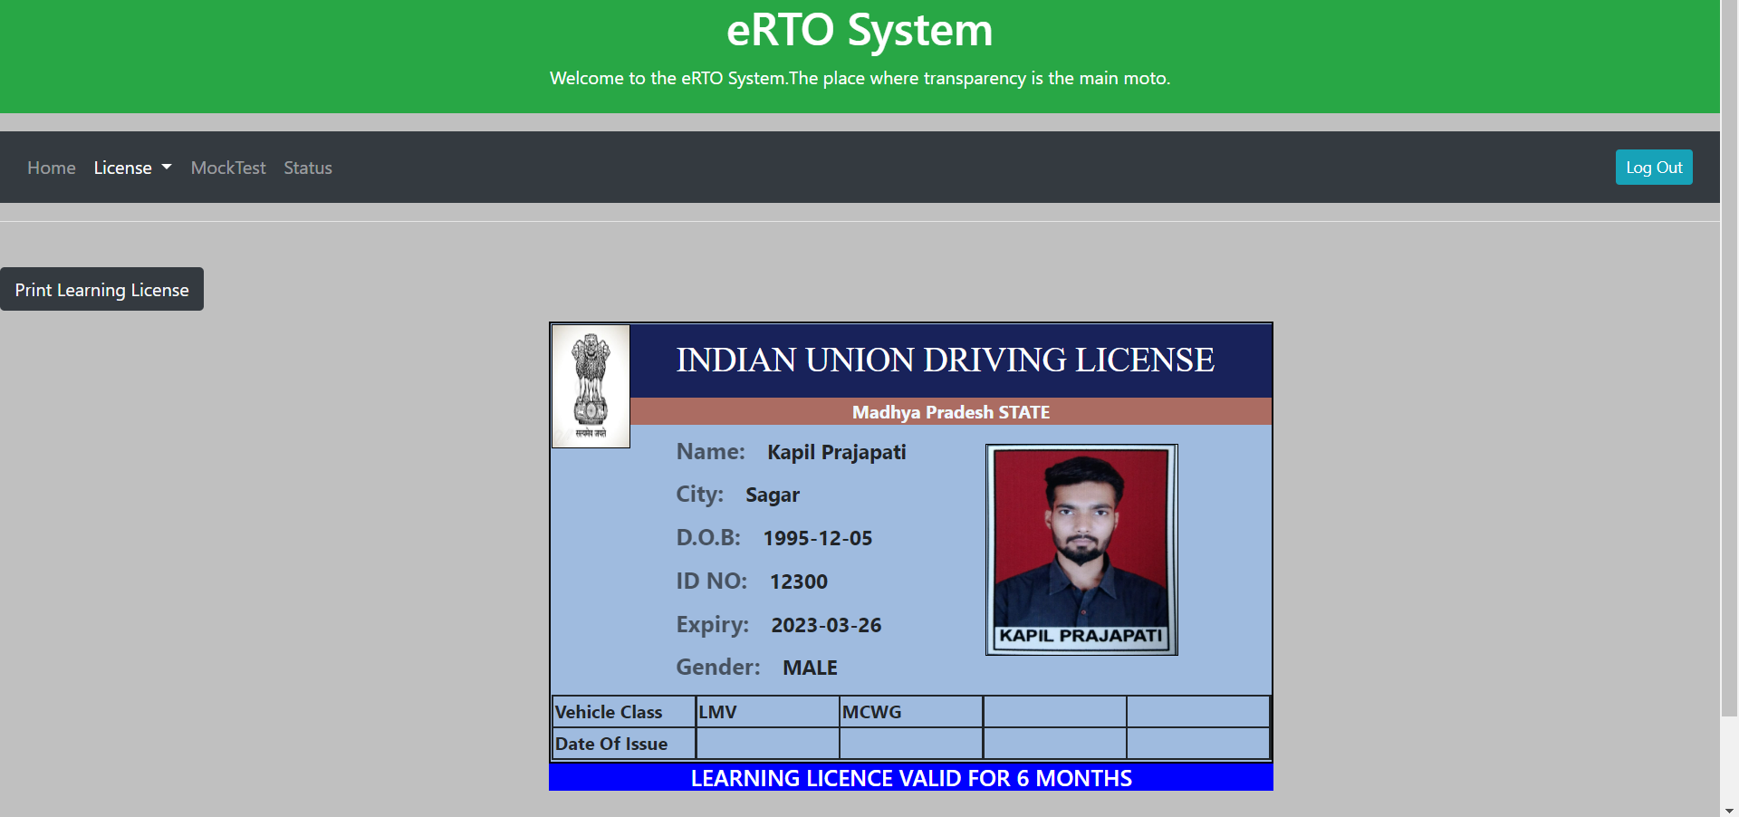
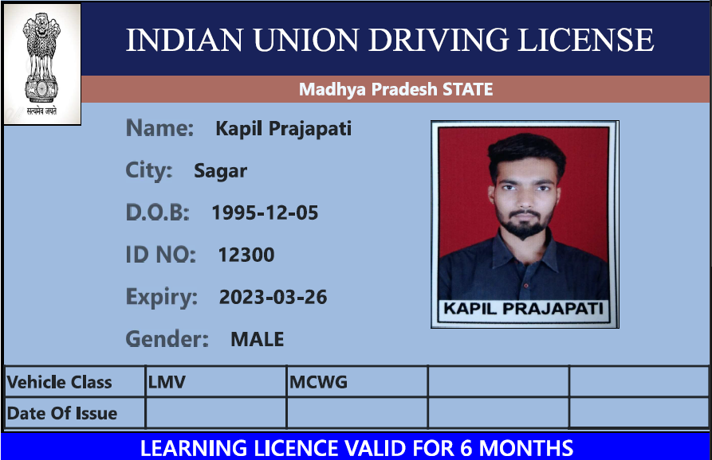

Slide 27
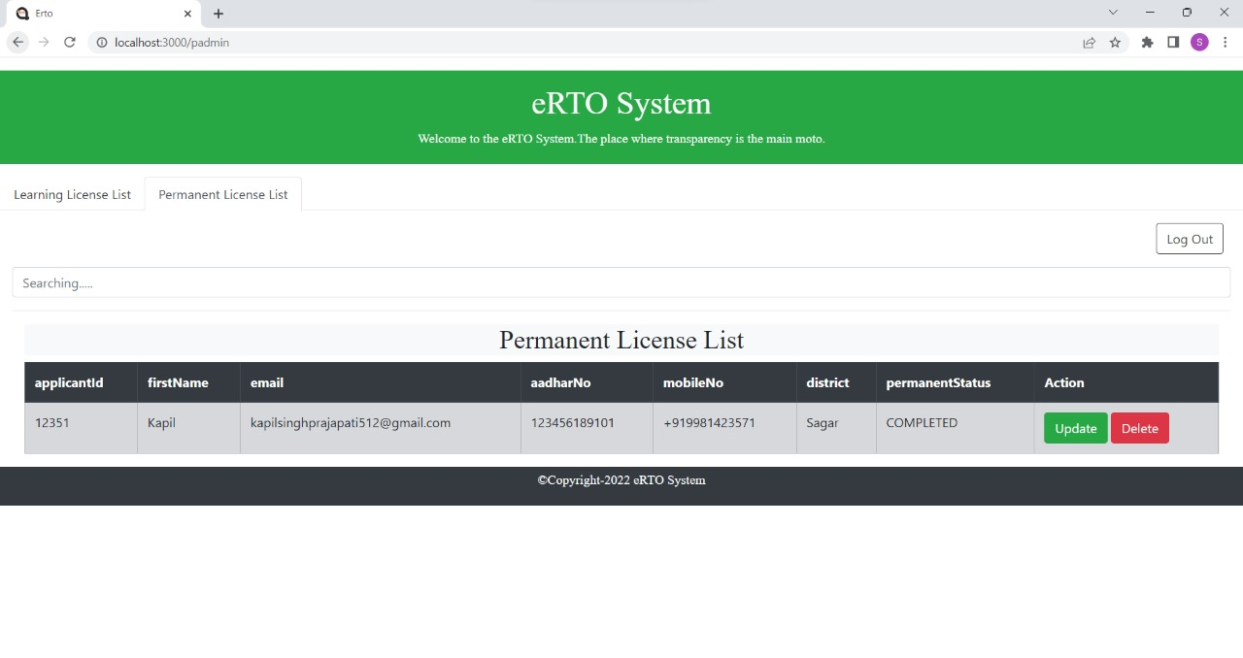
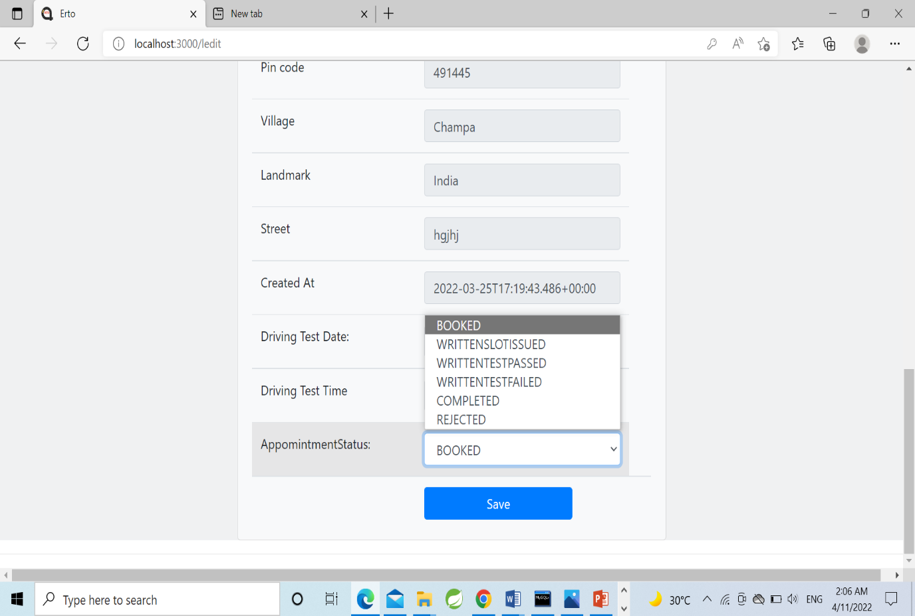

Slide 28
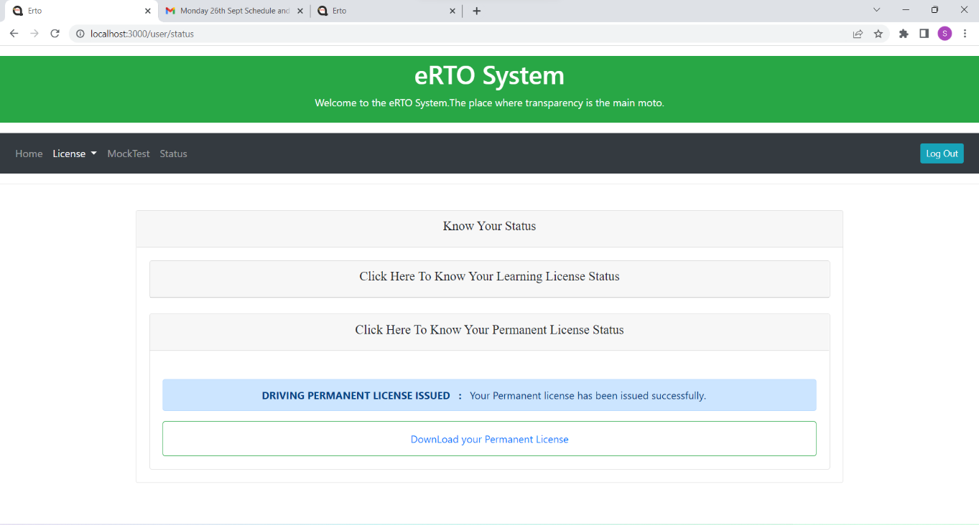
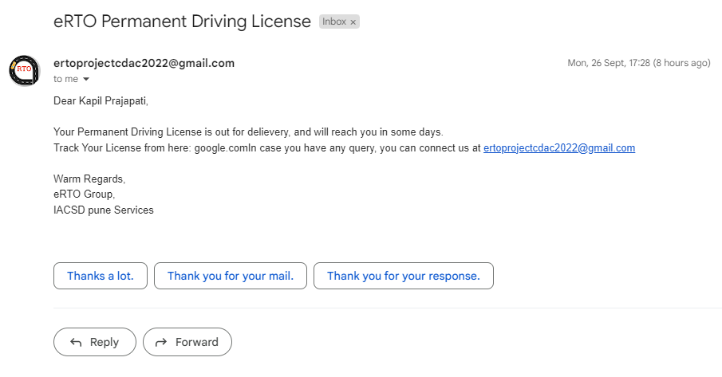
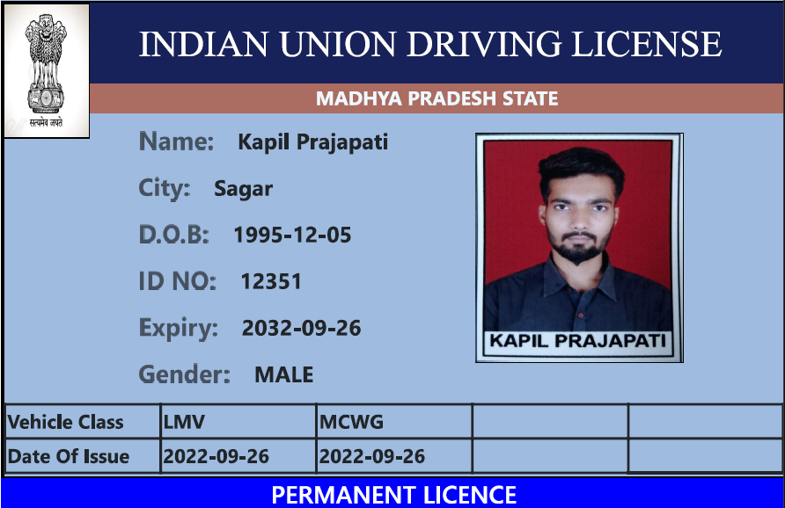

Slide 29
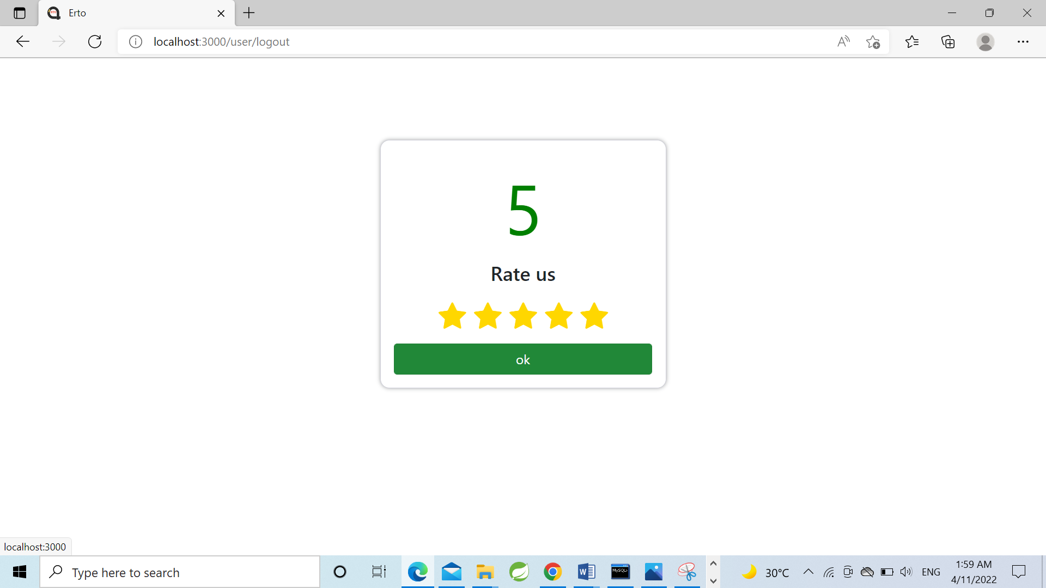

Slide 30
SPECIFICATION
The application will use React Js, jQuery, and CSS as the main web technologies. HTTP and FTP protocols are used as communication protocols. The SMTP protocol is used for Email communication.
Several types of validations make the web application a secured one and SQL injections can also be prevented.
Since E-RTO System is a web-based application, an internet connection must be established.
The E-RTO System will be used on PC(s) and will function via the internet
Or intranet in any web browser.

Slide 31
S/W AND H/W REQUIREMENTS
Server Side:-
Processor: Intel® Xeon® processor 3500 series
HDD: Minimum 500GB Disk Space
RAM: Minimum 4GB
OS: Windows 10
Database: MySQL
Client Side(minimum requirement):-
Processor: Intel Dual Core
HDD: Minimum 80GB Disk Space
RAM: Minimum 2GB
OS: Windows 7

Slide 32
ADVANTAGES
Managing information.
Effortless Communication.
Lesser time is required to maintain and manage records.
Paper work is reduced due to records stored in a database.
All requirements at one platform.

Slide 33
CONCLUSION
The system generated only a limited number of reports. If more detailed reports are required the system can be directed Even though the system has well communication facility, it’s not enough.
The mail service can be enhanced with features bcc, cc, etc. The system has full security but the account information is for the customer credit information.
Improved communication, and ease of access to RTO resources such as Registration forms, etc, will help foster a stronger user relationship.
E – RTO management will empower you to spend more time and effort developing your users’ lifelong learning license.
In this e-RTO management complete the global Module. (Anywhere Any Time)
In this system the main entity is Admin who has all the rights.
Here the main tasks of admin are update/delete registration, and license.

Slide 34
FUTURE SCOPE
This project can be enhanced further by adding some more features. The application is designed in such a way that any further enhancements can be done with ease. The system has the capability for easy integration with other systems. New modules can be added to the existing system with less effort. In the future, a new function or procedure can be easily added to the system through these classes. Or even a new class can be added.
The software is flexible enough to be modified and implemented as per future requirements. We have tried our best to present this free and user–friendly website to Regional Offices.

Slide 35
REFERENCES
React Tutorial (w3schools.com)
Learn Spring Boot | Baeldung
Spring Data JPA - Reference Documentation
React – A JavaScript library for building user interfaces (reactjs.org)
Bootstrap · the most popular HTML, CSS, and JS library in the world. (getbootstrap.com)

Slide 36

+919039203603
kapilsinghprajapati512@gmail.com
+91 99814 56979
ani.121jai@gmail.com

